Slide 1
EE724 Band-to-Band Tunnelling in FDX SOI MOSFET Collaborator: Synopsys
Harsh Pujare, Abhineet Agarwal, Kushagra Gehlot
Mentor: Jay Sonawane
Instructor: Udayan Ganguly

Slide 2
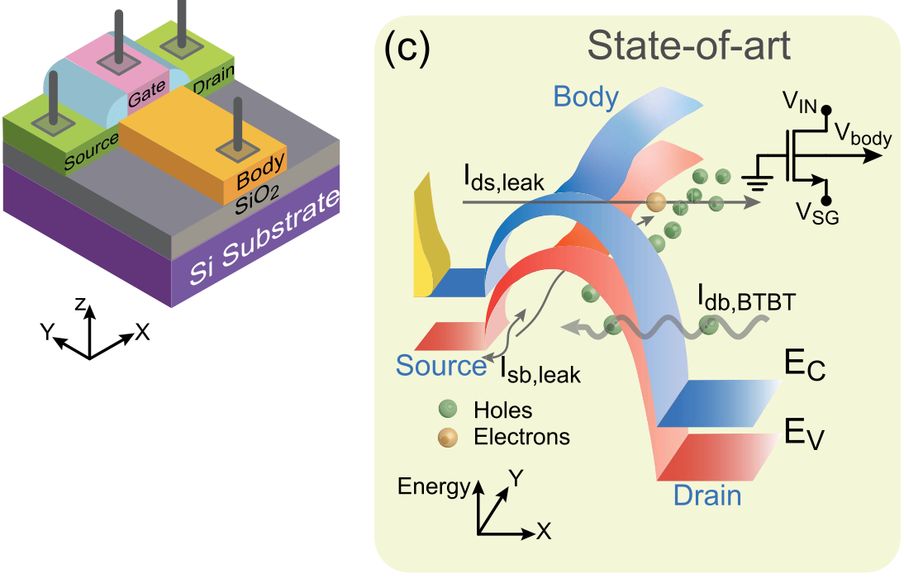
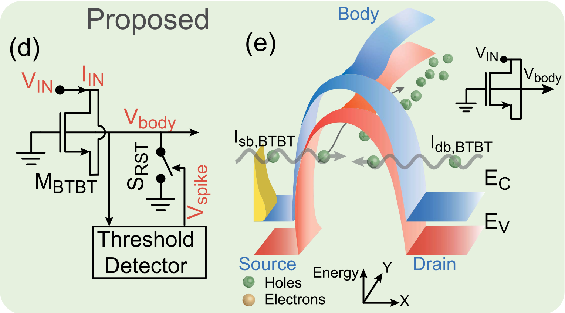
Outline
Phase 1:
Reduce BTBT current of BTBT integrator to enable ultra-low power implementations of LIF neuron.
Identify parameters which effect BTBT current in design space analysis.
Phase 2:
Inverter circuit with one BTBT transistor for output node integration (ON) and one transistor in SS region for discharging (OFF).
Maximise BTBT current by varying L(overlap), N(channel) and N(sd).

Slide 3
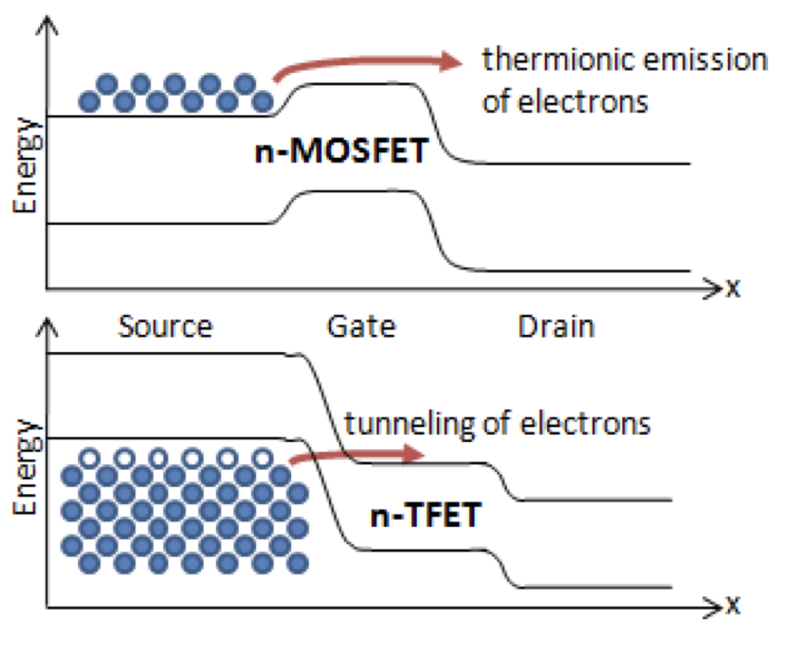
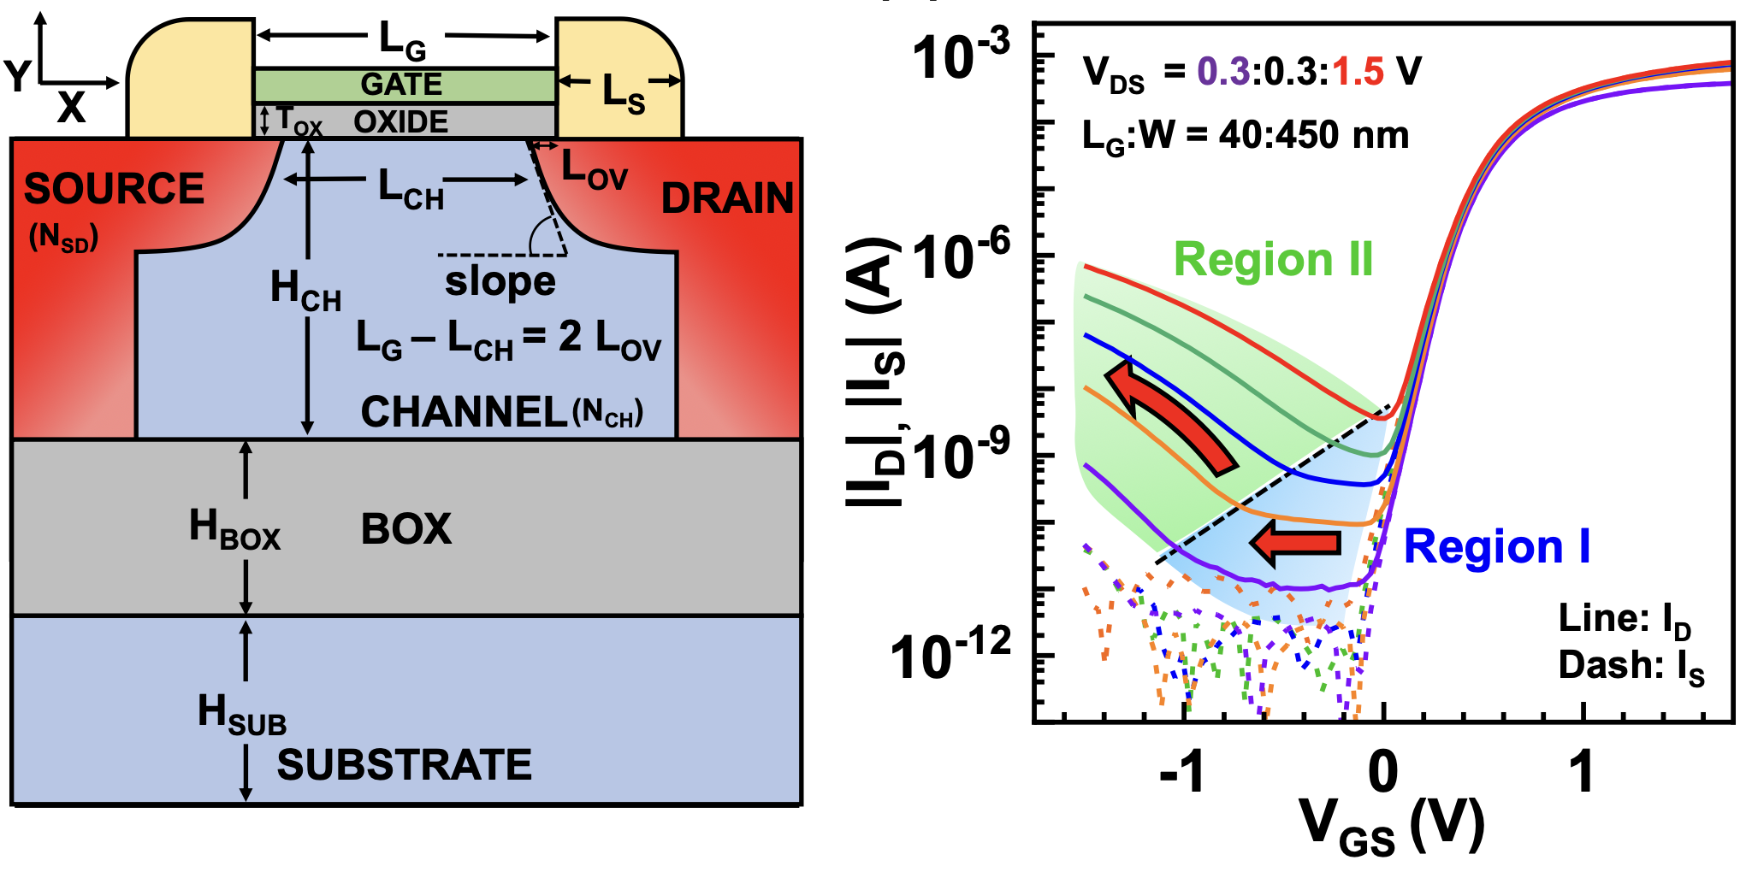
Motivation
At sufficiently high gate bias, Band-to-Band Tunneling occurs when the conduction band of the intrinsic region aligns with the valence band of the P region. This allow current to flow through the device.
Band-to-Band Tunneling can be used to obtain the low currents needed for slow neuronal integration on a biological timescale, to act as the Leaky-Integrate and fire neuron in a hardware neuronal implementation.
With high enough BTBT current, a BTBT inverter can be made: where the SOI-MOSFET body can be used to invert voltage from the input node, and a switch can be used to reset the built-up voltage in the ON state.

Slide 4
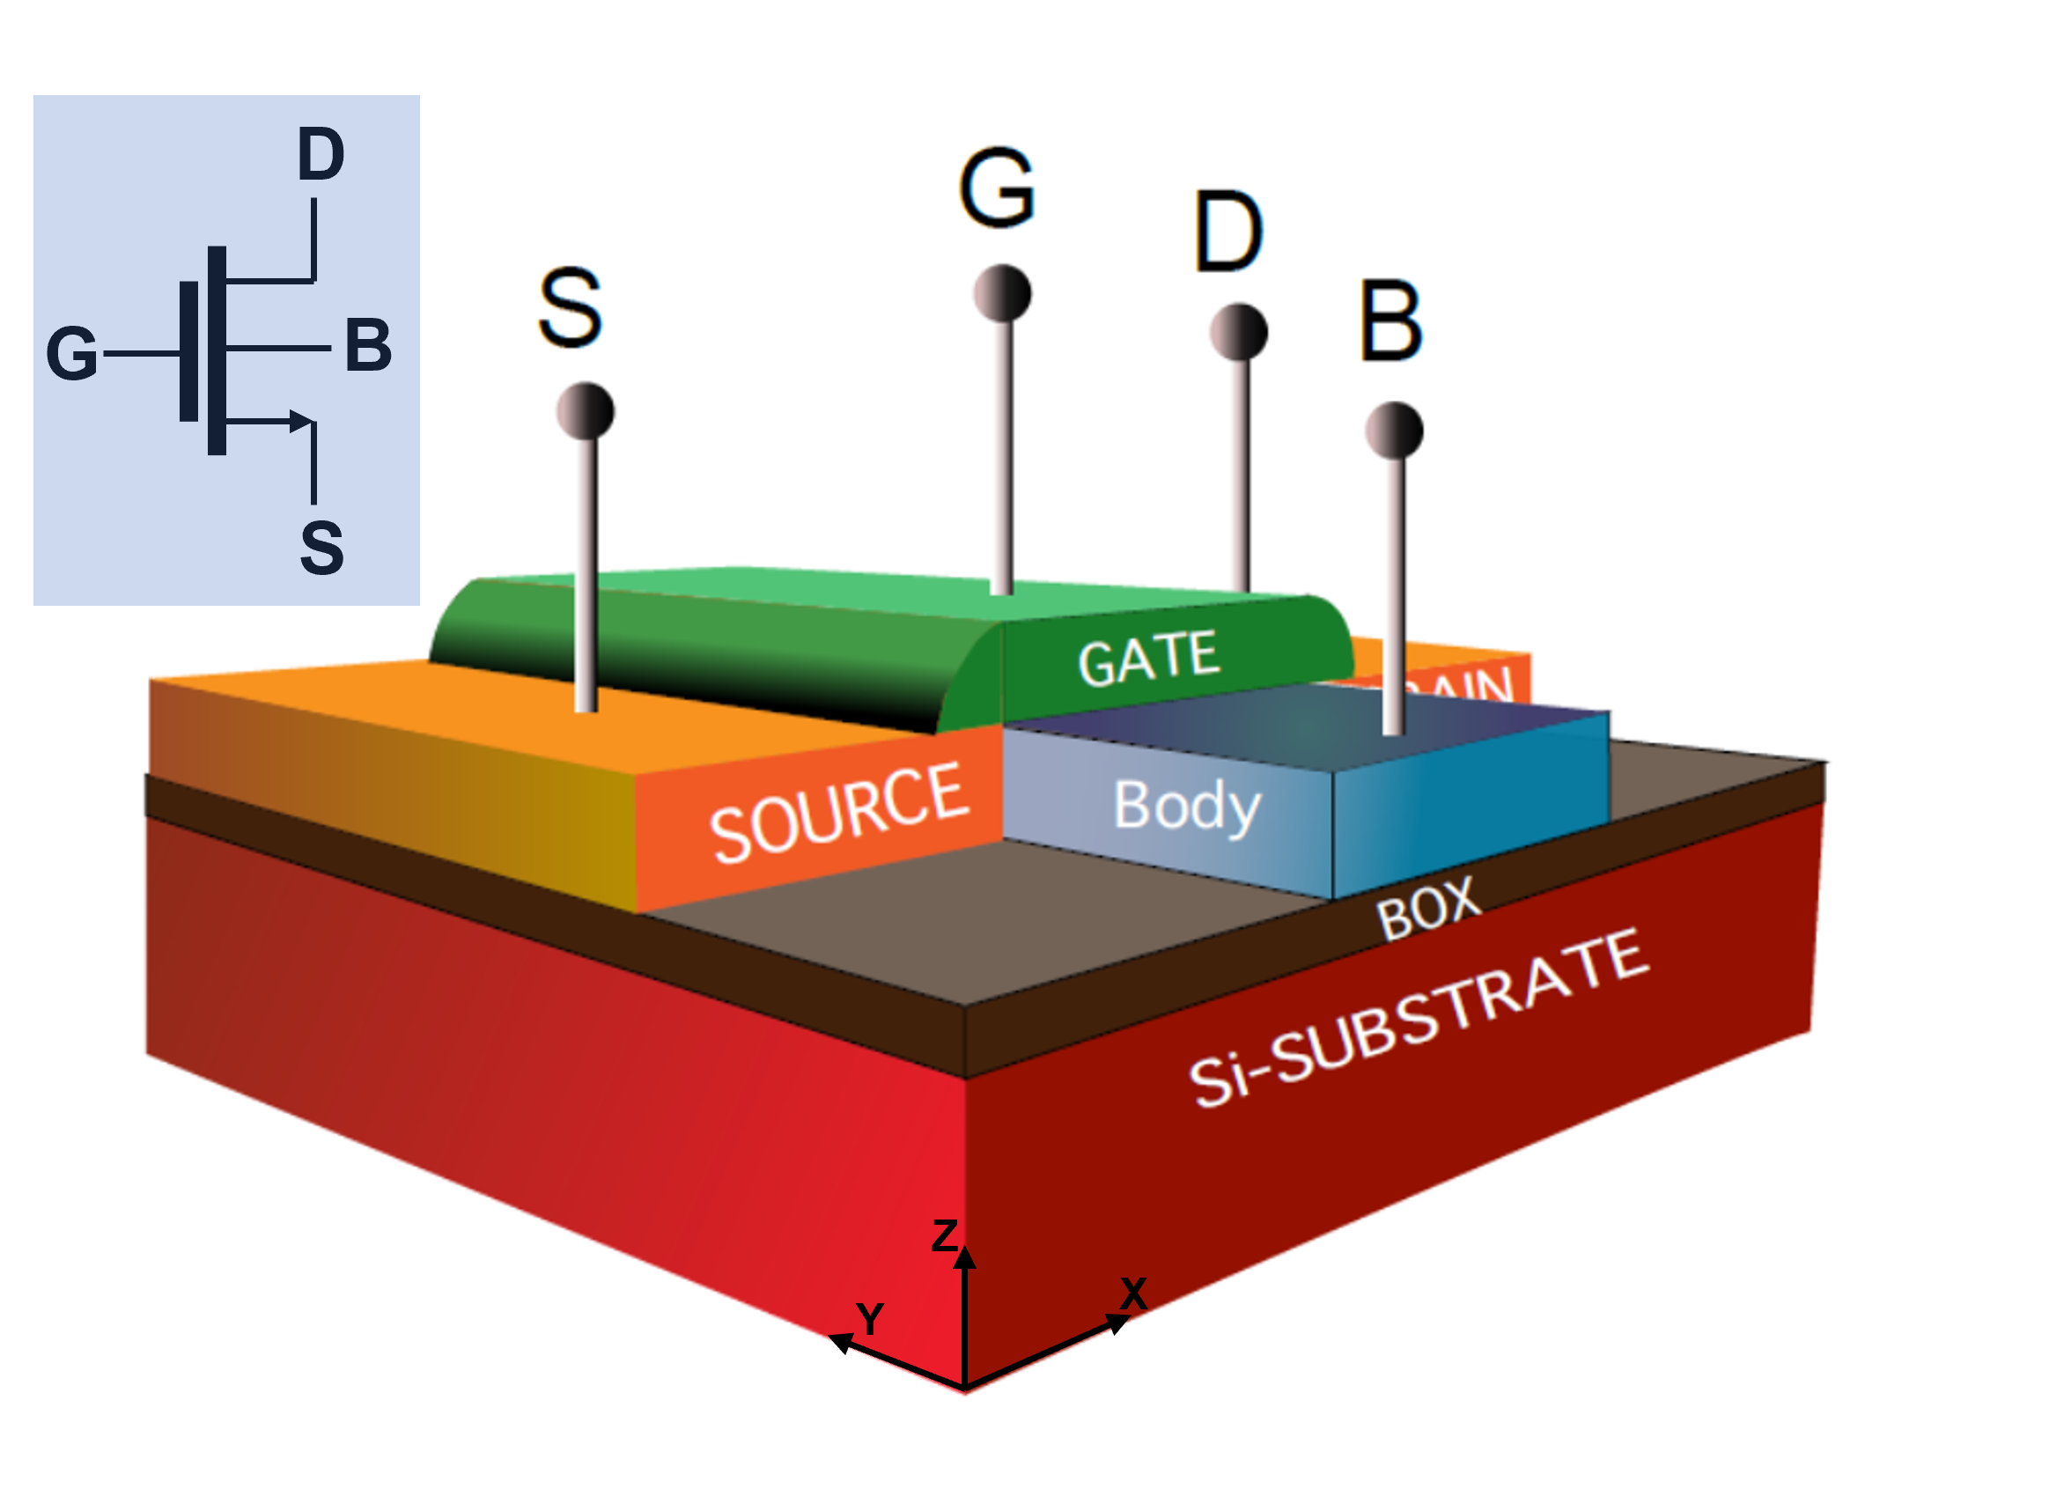
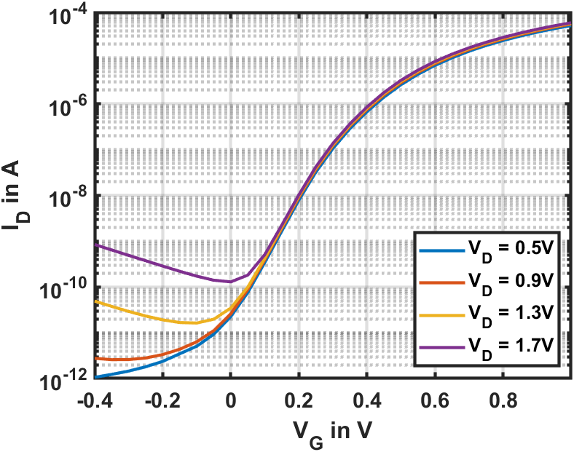
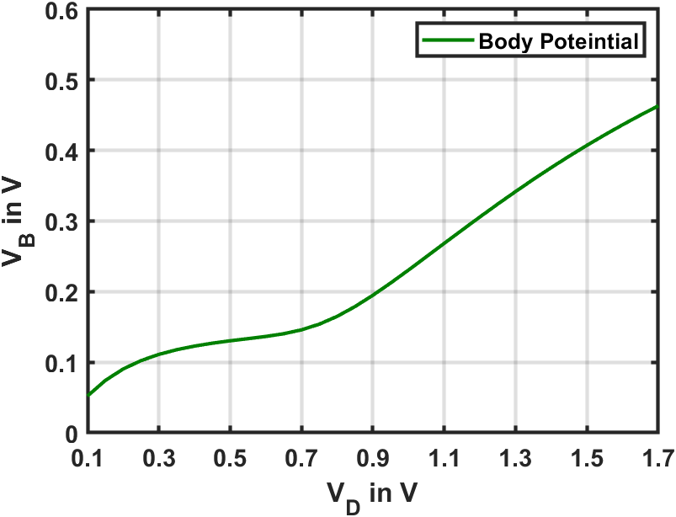
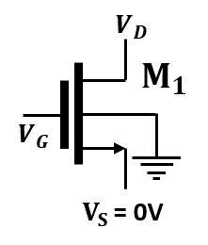
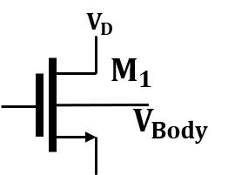
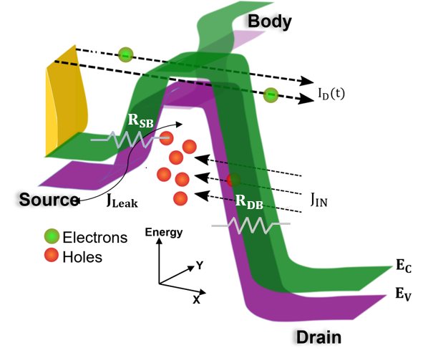
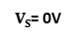
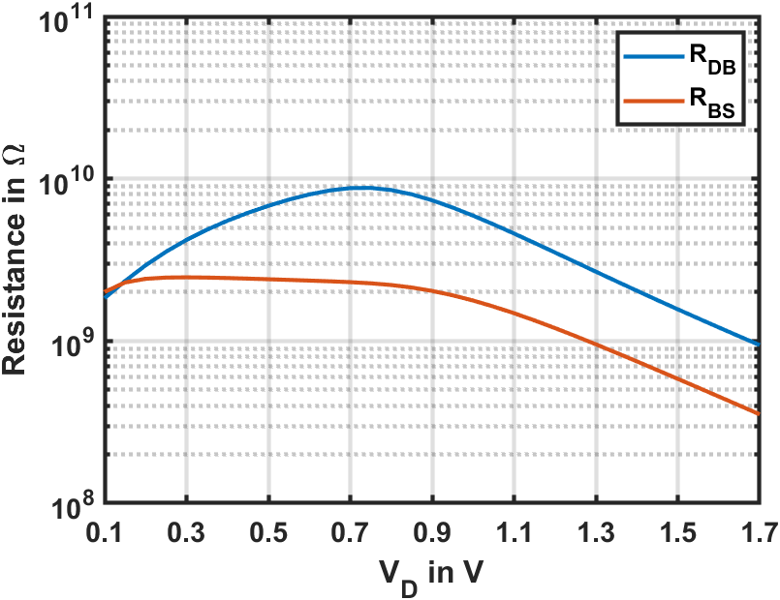
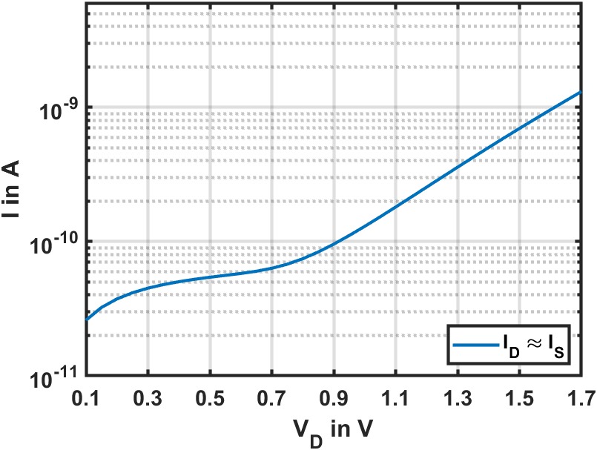
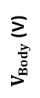
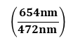
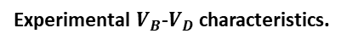
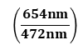
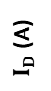
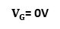
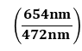
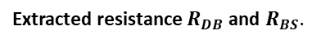
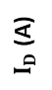
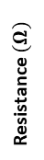
Background: Band to Band tunneling in SOI MOSFETs
$$\left(\frac{654nm}{472nm }\right)$$
$V_{G}$= 0V
Experimental
$V_{Body}$ (V)
$V_{S}$= 0V
$$\left(\frac{654nm}{472nm }\right)$$
p type
$I_{D}$ (A)
Due to BTBT
3-D device representation of the body contact PDSOI MOSFET
Experimental
Experimental ID-VG characteristics.
Experimental $V_{B}$-$V_{D}$ characteristics.
Experimental
Experimental
$V_{G}$= 0V
$$\left(\frac{654nm}{472nm }\right)$$
$V_{S}$= 0V
$I_{D}$ (A)
Resistance $(Ω)$
XY plane band diagram in the channel region.
Experimental ID-VD characteristics.
Extracted resistance $R_{DB}$and $R_{BS}.$
BTBT based circuits are extremely low power

Slide 5
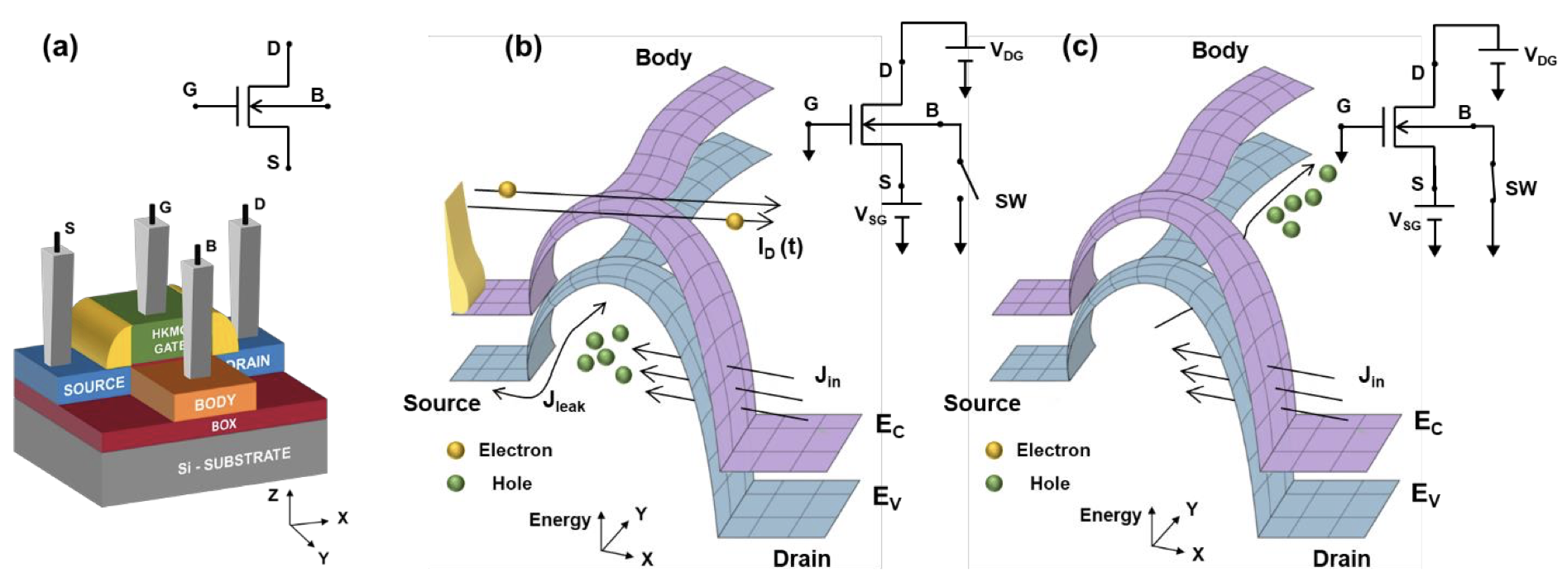
Device Details : PD-SOI MOSFET BTBT Integrator
Simulating the LIF part of the neuron, a large drain bias creates a tunneling induced hole storage (integration). The holes increase the potential of the floating body terminal, similar to membrane potential. A small fraction of the holes leakout through the body-source junction, creating a leakage current.
In the above diagrams, the gate terminal is grounded, used as a reference. V(sg) of the device is set to a small positive value (0.4V) to bias the device to deep threshold. The input is provided at the drain terminal, and the voltage output is taken at the body terminal.

Slide 6
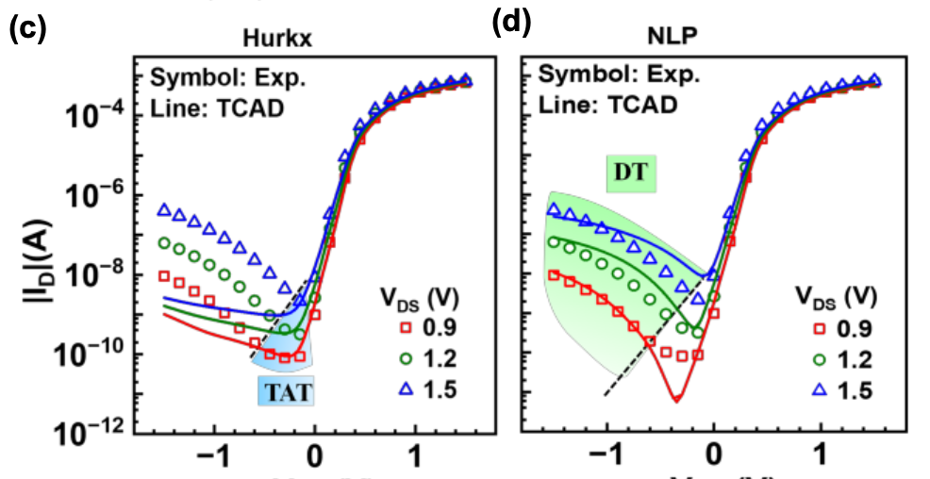
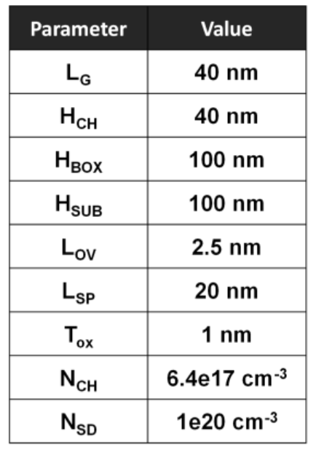
Device Details : PD-SOI MOSFET BTBT Integrator
Dynamic Non-Local Path (NLP) Tunneling and the Hurkx Model is used to model BTBT. At low bias, the main mechanism of BTBT is Trap-Assisted-Tunneling (TAT), while at higher biases, Direct Tunneling takes over.
The table shows the design space parameters used in the calibrated structures.

Slide 7
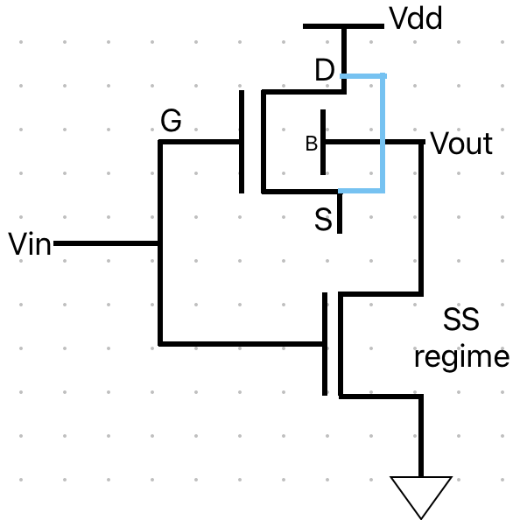
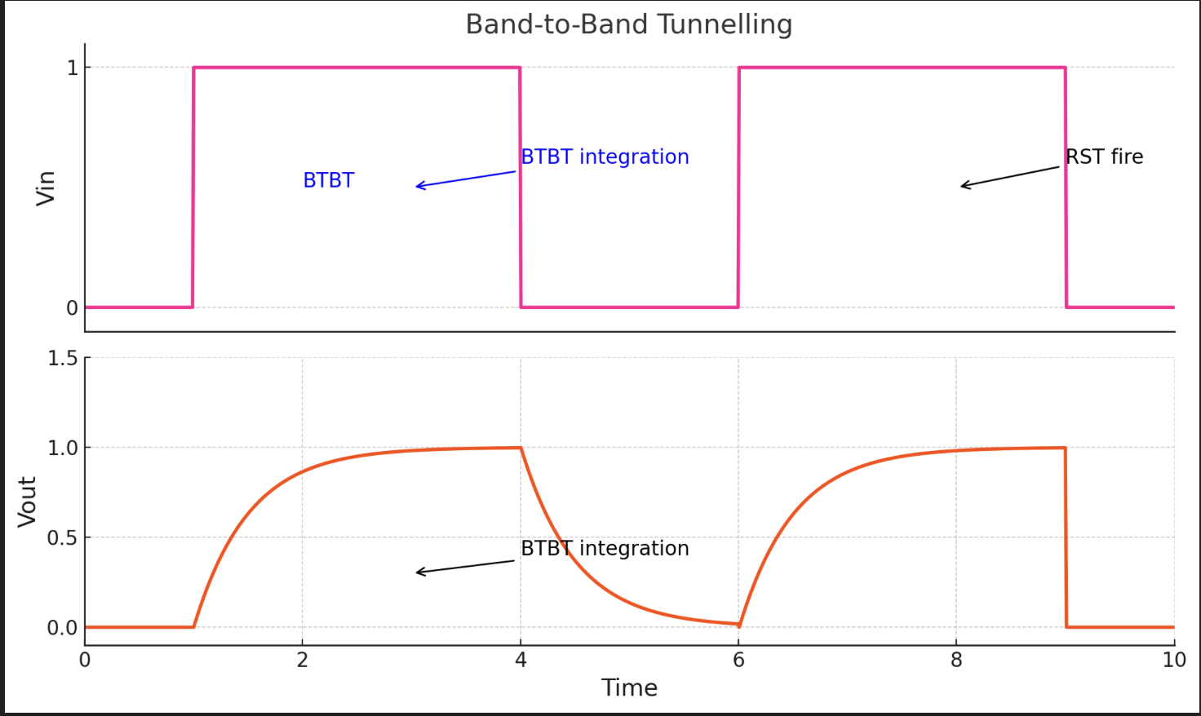
Device Details: FD-SOI MOSFET Inverter
A FD-SOI MOSFET working in the BTBT regime is used as an inverter. By applying no gate bias and shorting the source and drain, we try to obtain a large BTBT current – this is used to invert the output voltage. Activating the gate, the second MOSFET is used to discharge the built-up voltage due to tunneled holes in the body, to invert the ON state applied at the input voltage.
A high BTBT current is required for fast build-up of holes in the floating body.

Slide 8
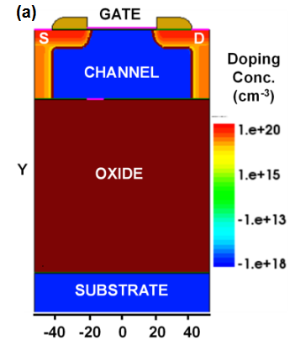
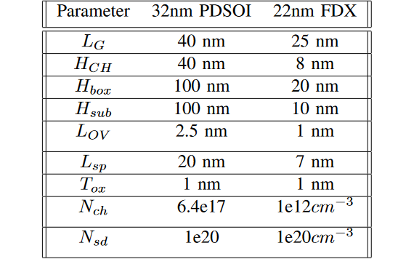
TCAD calibration
A Global Foundries 45nm SOI-MOSFET calibrated deck was given to us for further simulation in TCAD.
NLP (Non-Local Path) Model was used to simulate BTBT, for high gate-source biases.
A Partially Depleted SOI-MOS was used for the BTBT Integrator, while a Fully Depleted SOI-MOS was used for the BTBT Inverter.

Slide 9
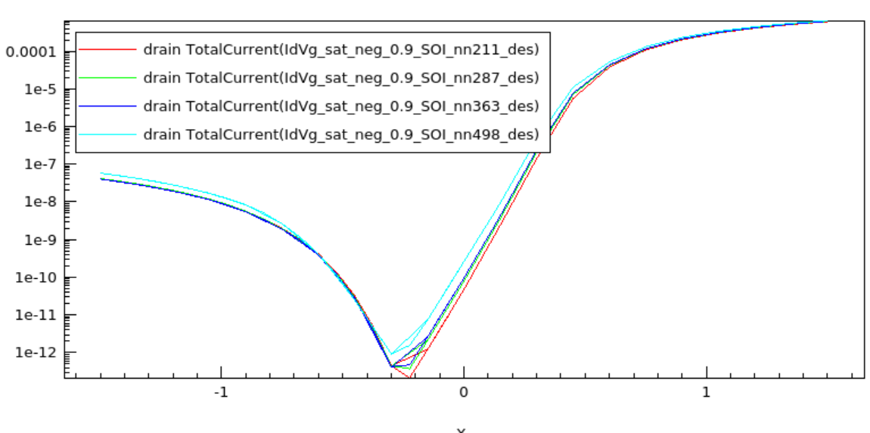
Impact of parameter variation-Stage 1
H_BOX variation for PDSOI 32nm
There is little change in current with change in H_box.
I-V characteristics plotted at HBOX of 10 nm, 25 nm, 40 nm and 100 n

Slide 10
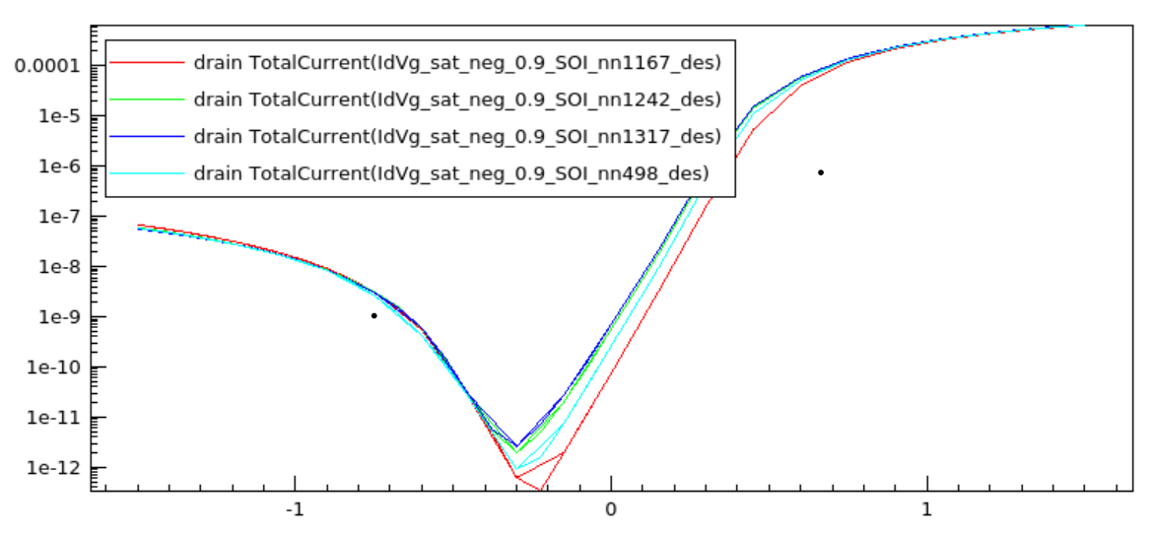
Impact of parameter variation-Stage 1
H_ch variation for PDSOI 32nm
There is little change in current with change in H_ch.
I-V characteristics plotted at H_ch of 10 nm, 25 nm, 40 nm and 100 n

Slide 11
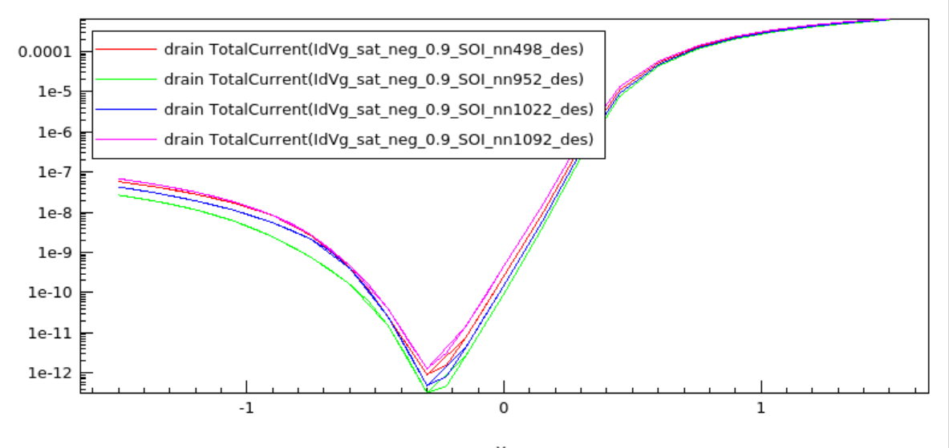
Impact of parameter variation-Stage 1
L_ov variation for PDSOI 32nm
Current increases with increase in L_ov.
2. I-V characteristics plotted at L_ov of 1 nm, 1.5 nm, 2.5 nm and 3.5 nm.

Slide 12
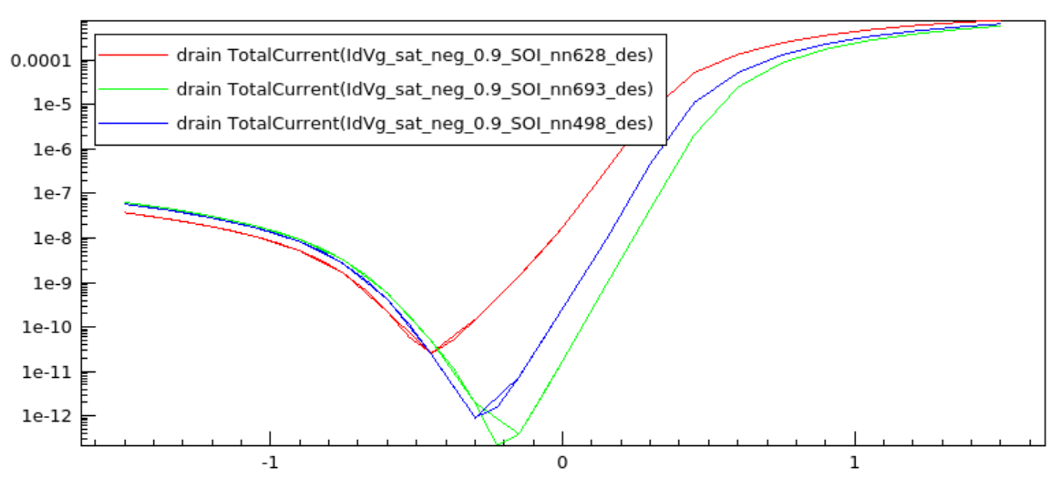
Impact of parameter variation-Stage 1
N_ch variation for PDSOI 32nm
Current increases with increase in N_ch.
2. I-V characteristics plotted at N_ch of 6.4e17, 1e17 and 5e16.

Slide 13
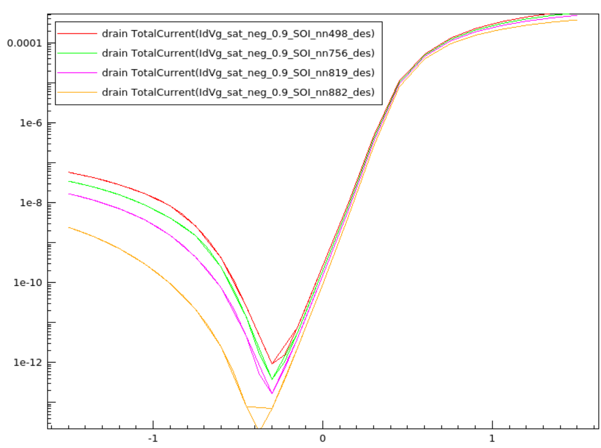
Impact of parameter variation-Stage 1
N_sd variation for PDSOI 32nm
Current increases greatly with increase in N_sd.
2. I-V characteristics plotted at N_sd of 1e20, 7e19, 5e19 and 3e19.

Slide 14
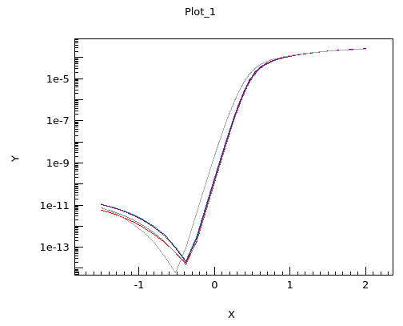
Impact of parameter variation-Stage 2
L_OV variation for FDX22
On increasing the drain-gate overlap, the BTBT current increases as expected.
I-V characteristics plotted at L_OV of 1 nm, 1.05 nm, 1.1 nm. 1.15 nm, 1.2 nm and 1.25 nm.

Slide 15
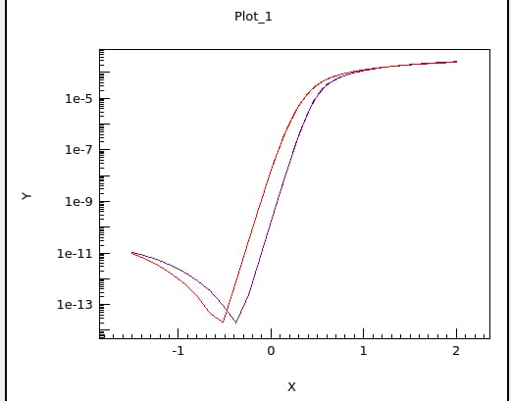
Impact of parameter variation-Stage 2
L_OV variation for FDX22
We observed that on increasing L_ov above 2.5 nm we get convergence issues.
But the convergence issues resolve above 7.5 nm, and the BTBT current at 7.5 nm is less than that at 2.5 nm.
BTBT current increase then until 10nm, beyond which again the simulations don't converge.

Slide 16
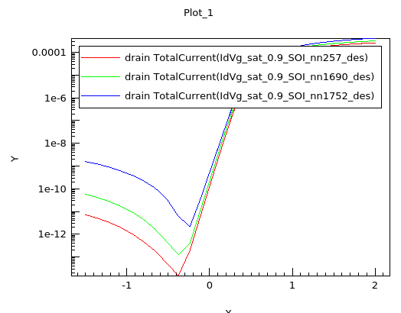
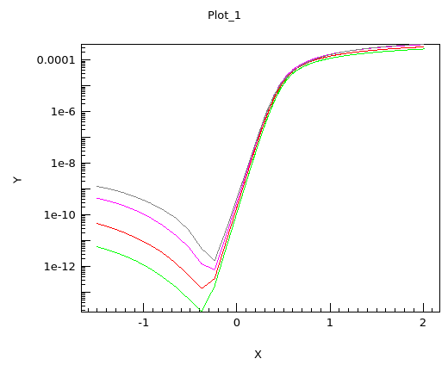
Impact of parameter variation-Stage 2
N_ch variation for FDX22
At L_ov of 1nm
At L_ov of 1.25nm
On increasing the channel doping, the BTBT current increases substantially.
I-V characteristics plotted at N_ch of 1e12, 1e14, 1e16 and 1e17.

Slide 17
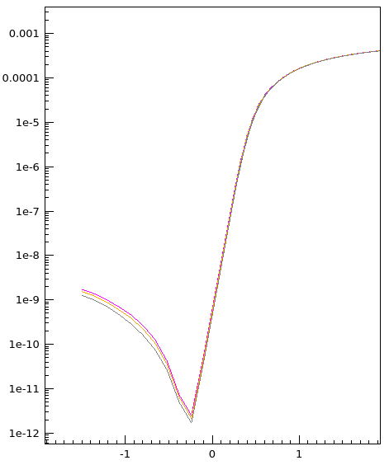
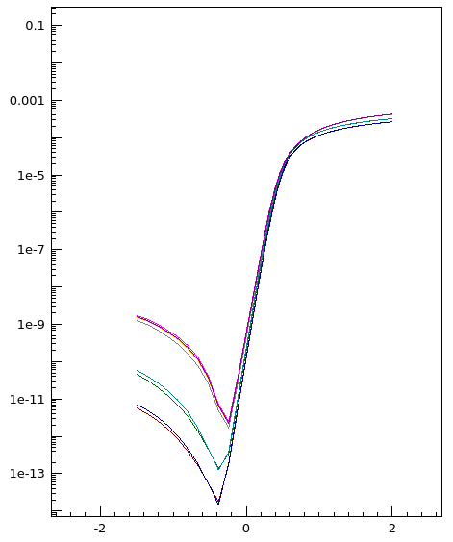
Impact of parameter variation-Stage 2
Optimal Device Design
We get maximum BTBT current at an L_ov of 1.4nm and N_ch of 1e17.

Slide 18
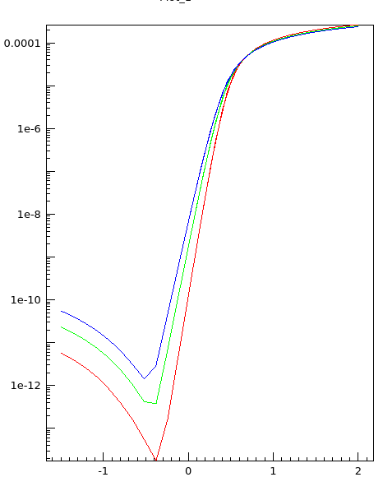
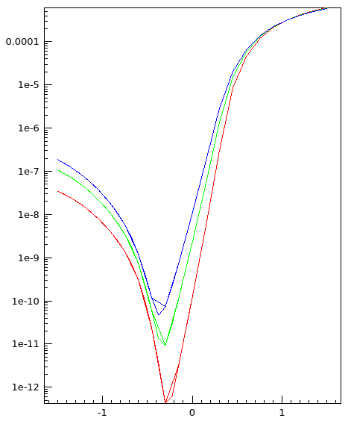
Impact of parameter variation-Stage 2
Temperature variability
22 nm
32 nm
BTBT current increases with increase in temperature.
Plots for 300 K, 358 K and 398 K.

Slide 19
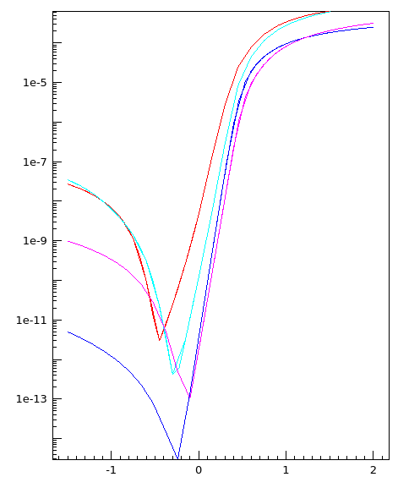
Impact of parameter variation-Stage 2
Scaling down from 32nm to 22nm
Just scaling down the lengths from 32nm PDSOI to 22nm FDXSOI or scaling them up from 22nm to 32nm is not enough.
2. In order to replicate the I-V characteristics, the channel doping also needs to be changed accordingly to ensure the channel is fully depleted in the 22nm case, and partially depleted in the 32nm case.

Slide 20
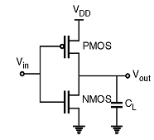
Conclusion and future work
VS
In the first stage, we performed design space and variability analysis to achieve a lower BTBT current. We inferred from the simulations that a low LOV, low NSD, and low NCH are favourable parameters for reducing the BTBT current.
In the second stage, we investigated the effects of L_G scaling from a 32nm PDSOI to a 22nm FDX SOI MOSFET n designed a FDX22 MOSFET to achieve higher BTBT current finding an optimal design at an L_OV of 1.4 nm and an N_ch of 1e17 cm-3. We also investigated the effect of temperature on BTBT current and observed that it increases with increase in temperature.
Future work may include fabricating a device based on the optimal design and investigating its efficacy as an inverter, as compared to CMOS inverters.

Slide 21
References
1] Paula Agopian et al. “Temperature impact on the tunnel fet off-state current components”. In: Solid-State Electronics 78 (Dec. 2012), pp. 141–146. DOI: 10.1016/j.sse.2012.05.053. [2] Tanmay Chavan et al. “Band-to-Band Tunneling Based Ultra-Energy-Efficient Silicon Neuron”. In:IEEE Transactions on Electron Devices 67.6 (2020), pp. 2614–2620. DOI: 10.1109/TED.2020.2985167. [3] Robert Entner. “Modeling and Simulation of Negative bias temperature Instability”. PhD thesis. Vienna University of Technology, 2007. [4] Koichi Fukuda et al. “On the nonlocal modeling of tunnel-FETs Device and Compact models”. In: 2013. URL: https : / / api semanticscholar . org / CorpusID :221968337. [5] G.A.M. Hurkx, D.B.M. Klaassen, and M.P.G. Knuvers. “A new recombination model for device simulation including tunneling”. In: IEEE Transactions on Electron Devices 39.2 (1992), pp. 331–338. DOI: 10.1109/16.121690. [6] A. Schenk. “Rigorous theory and simplified model of the band-to-band tunneling in silicon”. In: Solid-State Electronics 36.1 (1993), pp. 19–34. ISSN: 0038-1101. DOI: https://doi.org/10.1016/0038-1101(93)90065-X. [7] Sentaurus Device Manual. Synopsys. Santa Clara, 2010. [8] Ajay Kumar Singh et al. “Quantum Tunneling Based Ultra-Compact and Energy Efficient Spiking Neuron Enables Hardware SNN”. In: IEEE Transactions on Circuits and Systems I: Regular Papers 69.8 (2022), pp. 3212–3224. DOI: 10.1109/TCSI.2022.3172176. [9] Jay Sonawane et al. Design Space and Variability Analysis of SOI MOSFET for Ultra-Low Power Band- to-Band Tunneling Neurons. 2023. arXiv: 2311.18577 [physics.app-ph]. [10] Yuan Taur and Tak H. Ning. Fundamentals of modern VLSI devices. Cambridge University Press, 199

